Slide 1


Visvesvaraya Technological University
INTERNSHIP SEMINAR PRESENTATION ON CONSTRUCTION OF RETAINING WALL (THANISANDRA)
Presentation by
MANOJ, K. S. (1VK16CV014)
Under the guidance of
Dr. H.K. Lakshmipathaiah,
Professor of Geology
Department of Civil Engineering
VIVEKANANDA INSTITUTE OF TECHNOLOGY
2021-22

Slide 2
CONTENT OF CONSTRUCTION
INTRODUCTION
COMPANY OVERVIEW
SOIL TESTING
SITE MARKING
EXCAVATION
PCC
FOOTING
CONSTRUCTION OF RETAINING WALL
CONCLUSION

Slide 3
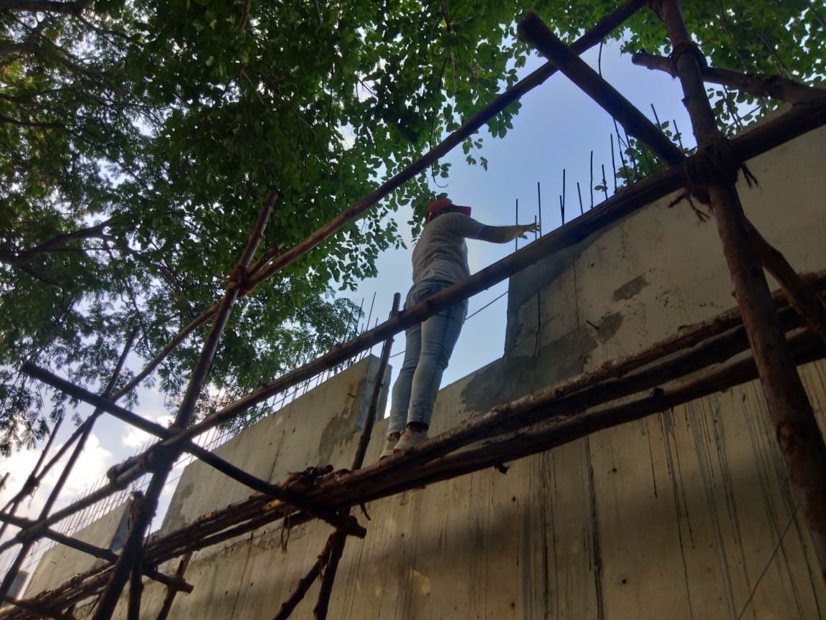
INTRODUCTION
RETAINING WALL BUILDING
A retaining wall is a structure designed and constructed to resist the lateral pressure of soil, when there is a desired change in ground elevation that exceeds the angle of repose of the soil.

Slide 4
COMPANY OVERVIEW
KALIKA INFRA founded the company in 23RD June of the year 2014. As of September 2016 KI had launched first residential project under the name of KALIKA MAX PLUS in Bangalore and also launched first plot development under the name of Harisree Garden' in Shivamogga.
They provide short and long term trainings for the students and make them professionally suitable for the various requirements of the construction sector.
At present they are working in different government departments and private construction works.
Near Nelamangala they are developing a private Villas and appartments.

Slide 5
CONSTRUCTION DETAILS CARRIED OUT
TYPE OF BUILDING : ARMORY BUILDING
LOCATION : THANISANDRA,HEGDE NAGAR
BANGLORE-560077

Slide 6
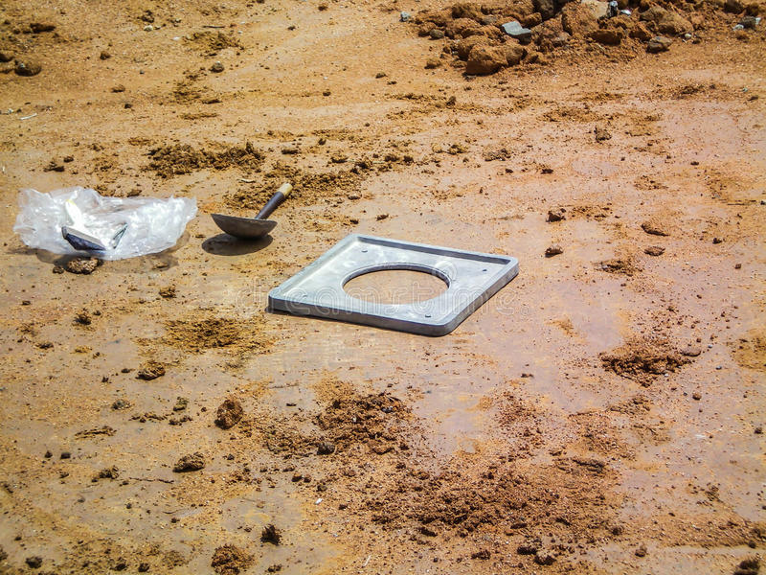
SOIL TESTING
Soil testing reveals the physical and engineering properties of soil like moisture content, mineral presence, density, permeability and bearing capacity.

Slide 7
SITE MARKING
Site marking is one of the starting point of construction. In this activity Engineer and Mistry will identify pillar placements. Once pillars placement is identified based on soil condition earth work will start. Depending on soil condition pillar depth will vary.
The purpose of marking is to identify clearly the site of incision or insertion. Marking is carried out at the intended site of the incision or as near as possible to the intended site. Unless clinically necessary, no other point should be marked besides the surgical site. The mark must not be ambiguous.

Slide 8
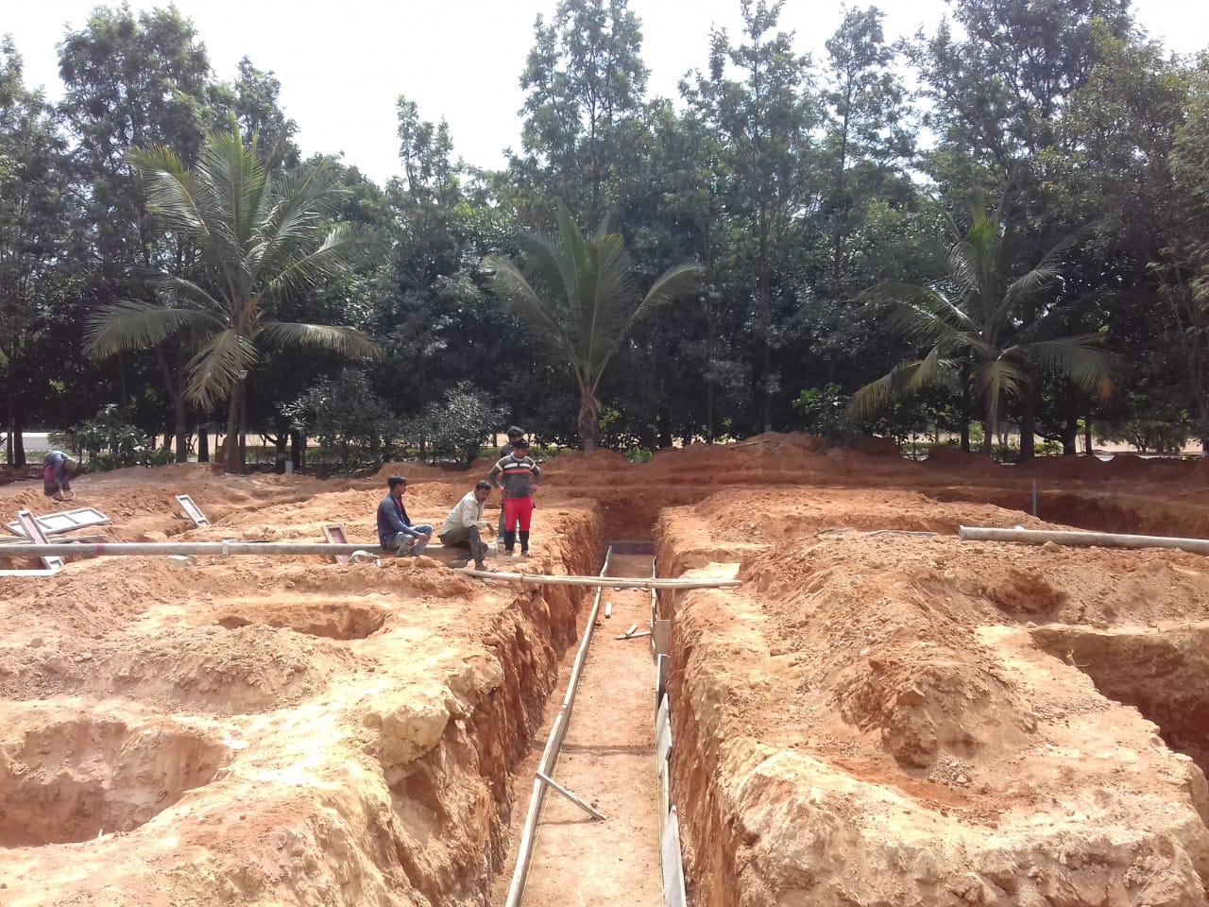
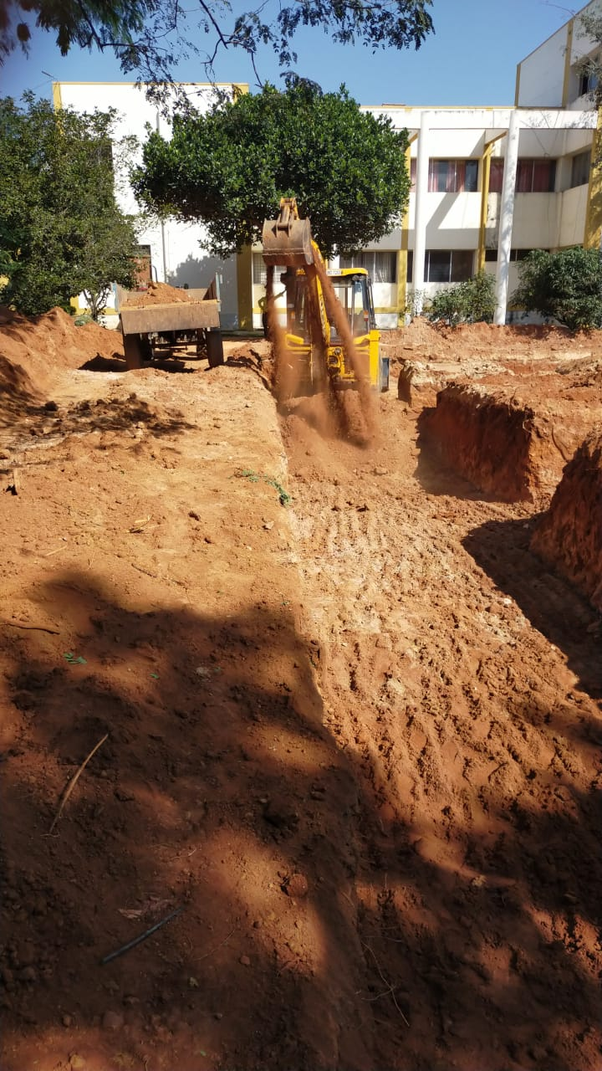
EXCAVATION
Excavation is the process of moving earth, rock or other materials with tools, equipment or explosives. It also includes trenching, wall shafts, tunnelling and underground. It is the preliminary activity of the construction project.

Slide 9
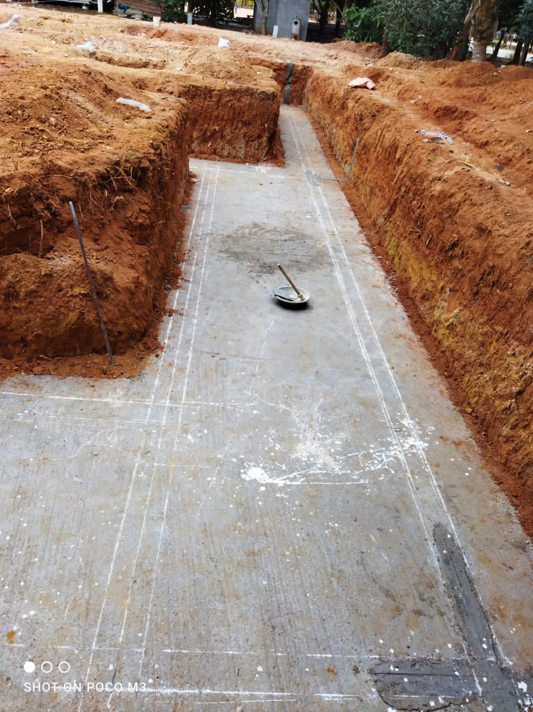
PCC
Plain cement concrete is the mixture of cement, fine aggregate(sand) and coarse aggregate without steel. PCC is an important component of a building which is laid on the soil surface to avoid direct contact of reinforcement of concrete with soil and water.

Slide 10
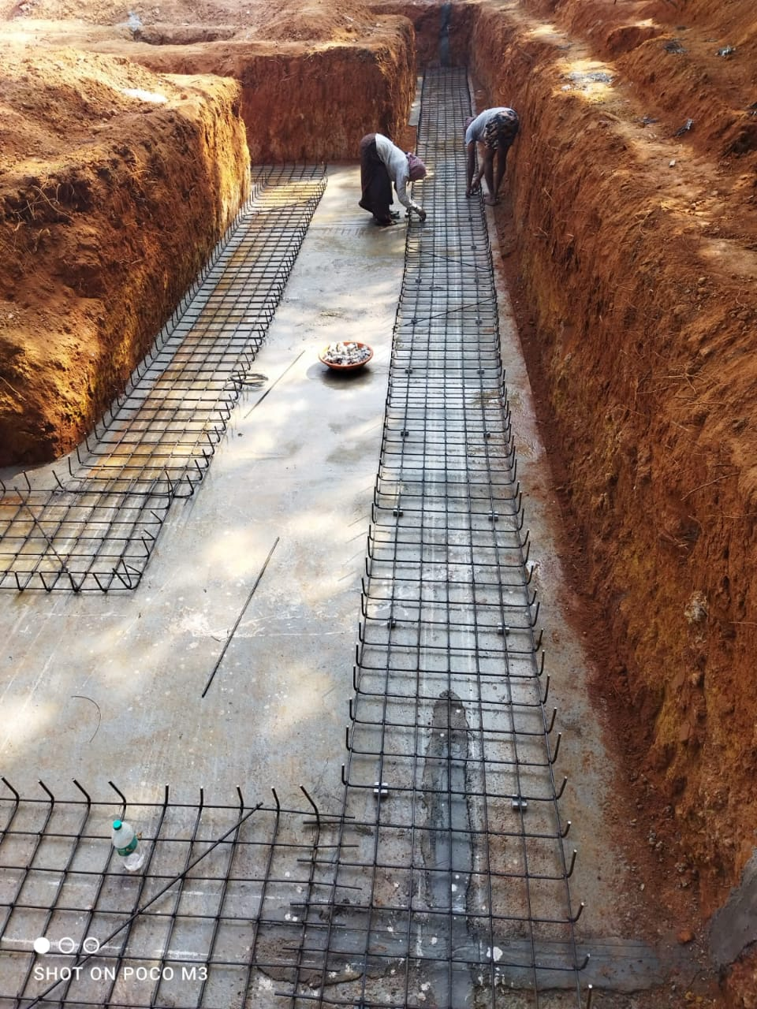
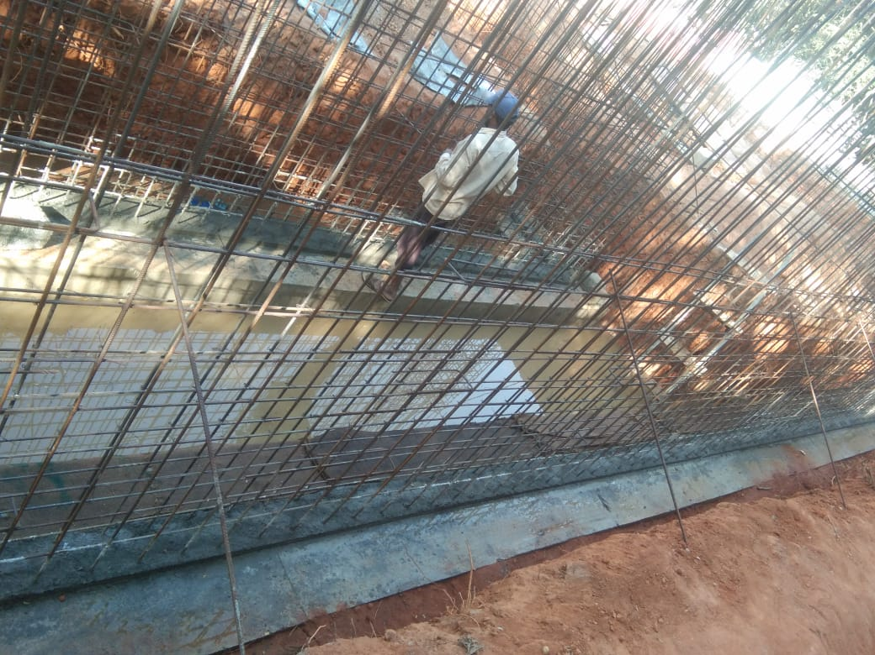
FOOTING MAT
Footing means a foundation unit constructed in brick work, masonry or concrete under the base of a wall or column for the purpose of distributing the load over a large area.

Slide 11
RETAINING WALL
Retaining walls are relatively rigid walls used for supporting soil laterally so that it can be retained at different levels on the two sides
Retaining wall is a structure that are designed and constructed to withstand lateral pressure of soil or hold back soil materials.
A Retaining wall is a structure that holds or retains soil behind it.

Slide 12
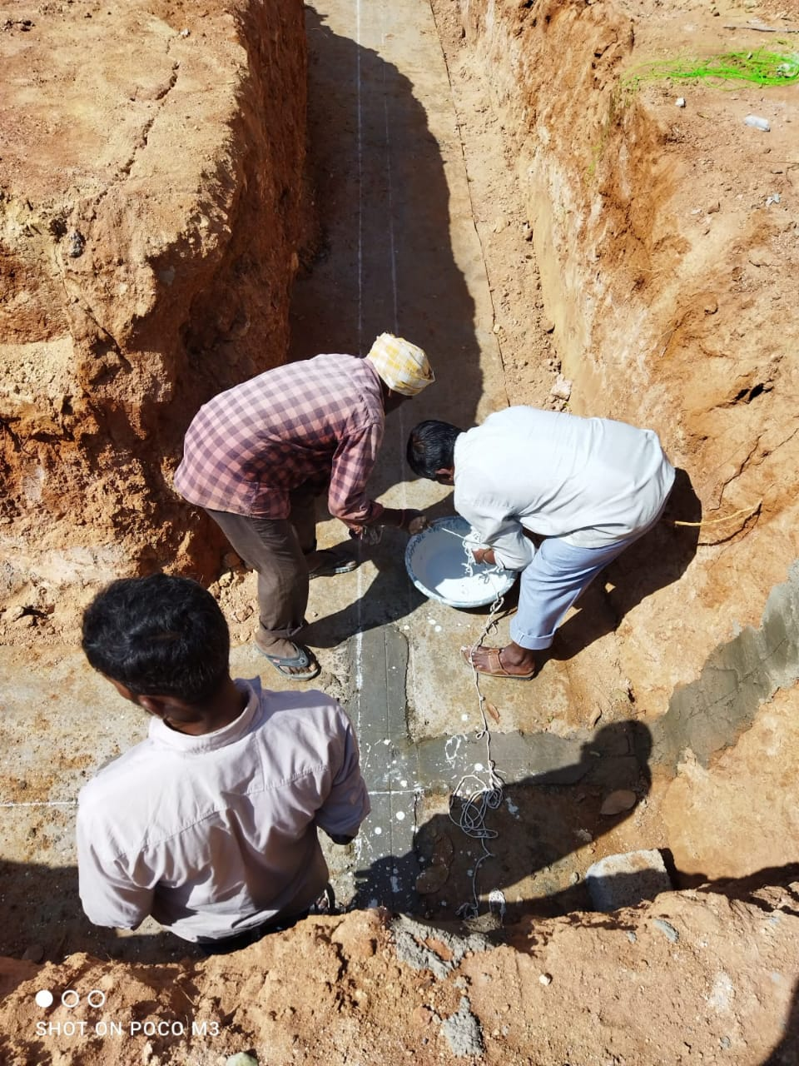
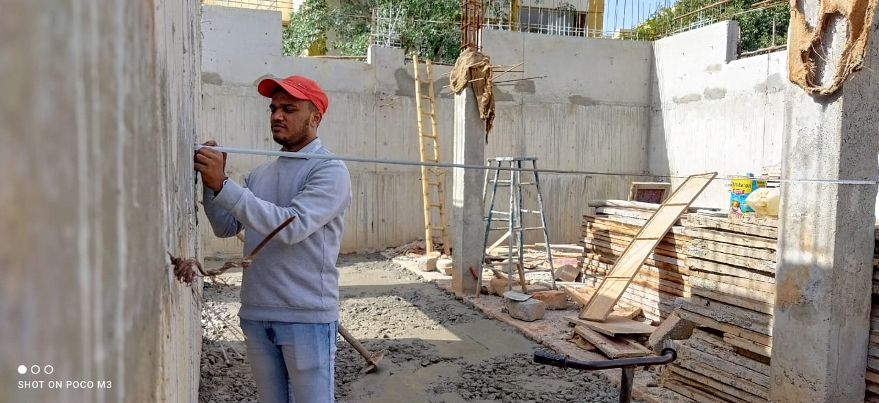
COLUMNS
A column or pillar in architecture and structural engineering is a structural element that transmits, through compression, the weight of the structure above to other structural elements below.

Slide 13
PLINTH BEAM
Plinth beam is a reinforced concrete beam constructed between the wall and its foundation. Plinth beam is provided to prevent the extension or propagation of cracks from the foundation into the wall above when the foundation suffers from settlement.

Slide 14
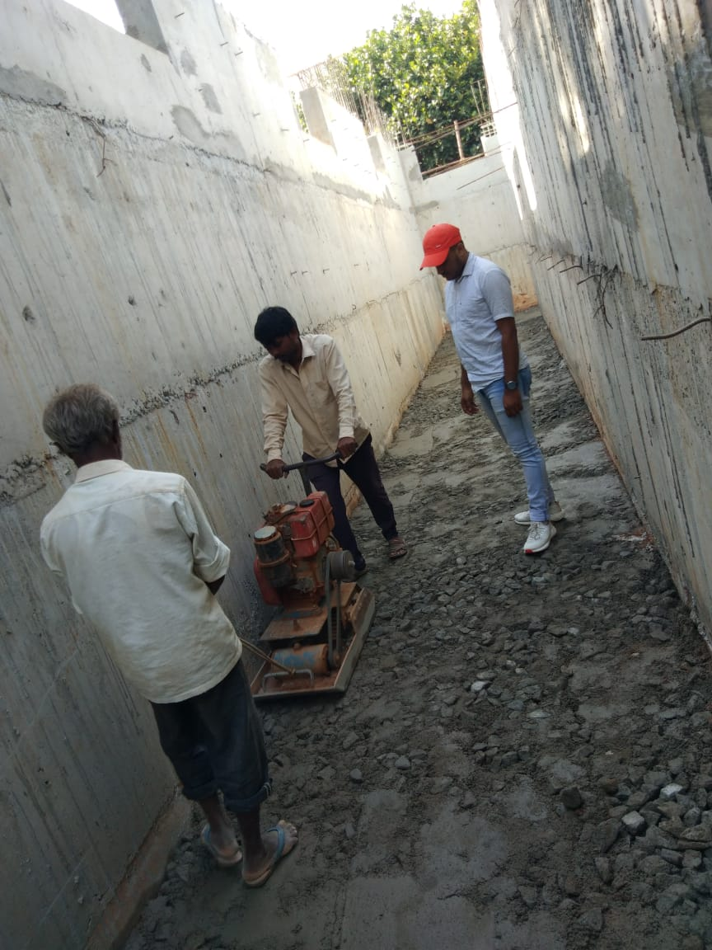
PCC ABOVE THE PLINTH LEVEL
It stand for Damp proof concrete. It is same like PCC which is generally provided below the plinth level of the building or structure. It's depth is about 40mm.

Slide 15
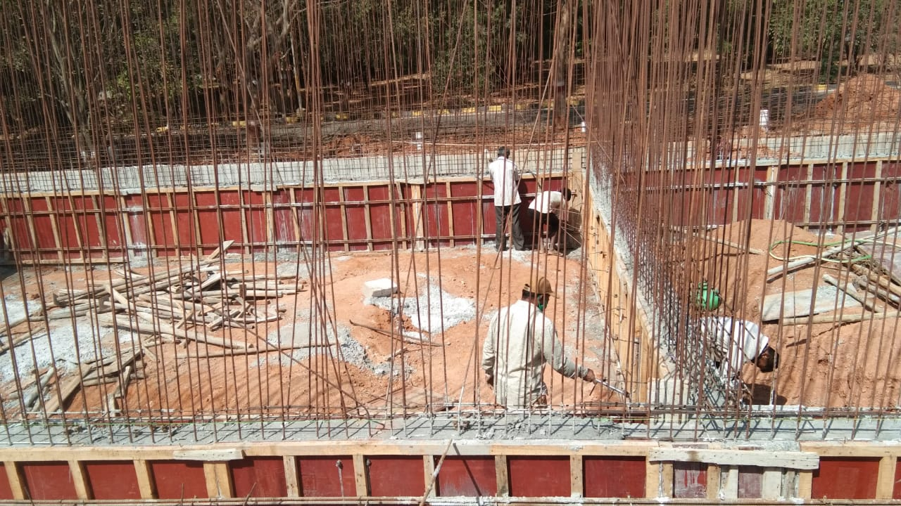
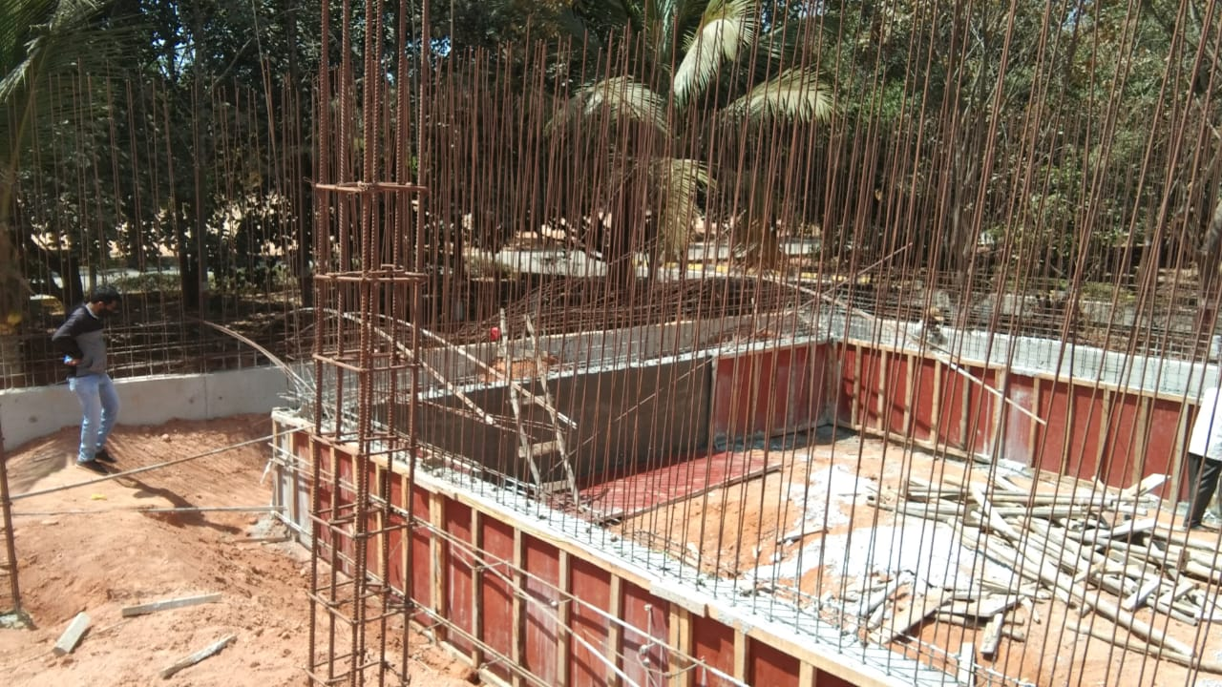
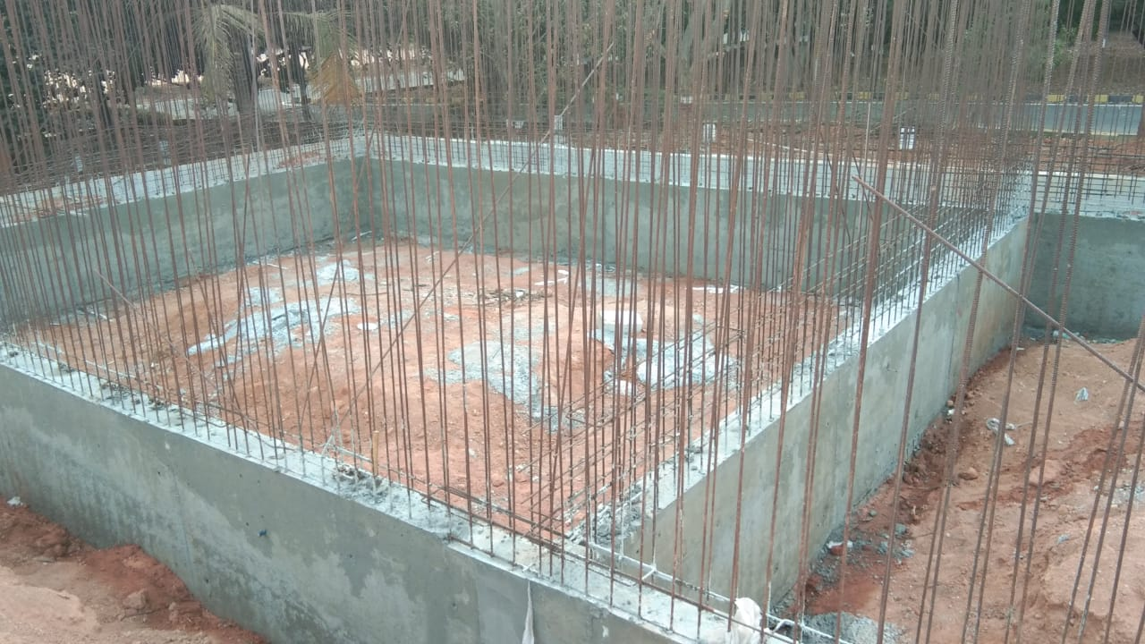
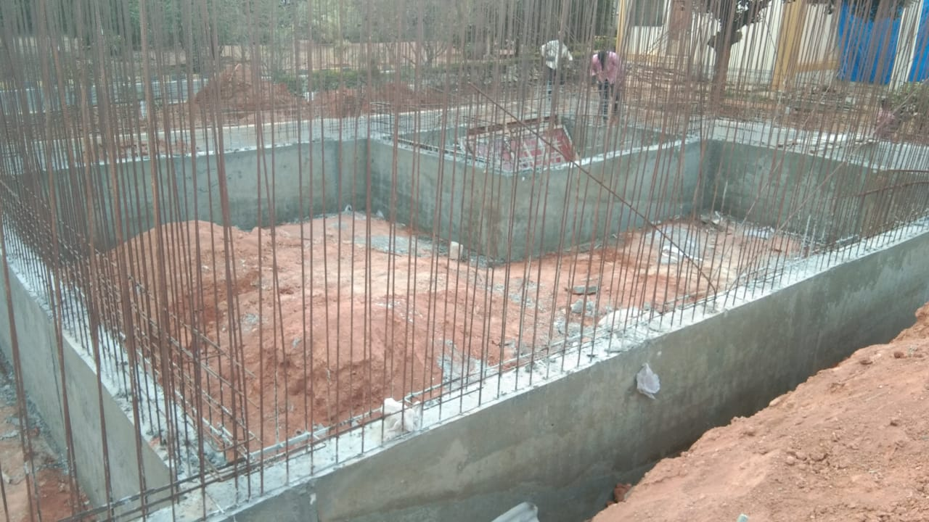

Slide 16
CONCLUSION
Internship provides opportunity to explore the field of interest in civil works.
Gained basic knowledge in the field.
Learn about safety requirements in the site.
It has been an excellent and rewarding experience.
I can conclude that there have been a lot I've learnt from my work.

Slide 17


